Slide 1
Instructions and Review Process
Copy and Edit Away!
Use Our Resources
Submit for Review
To edit, go to File -> and select ‘Make a Copy’. There are editable regions within the template where you can begin to plug-in your content. Please do not edit the slide master (font type, placement, logo, color or general layout). We recommend printing these full-bleed (so the color meets the edge of the paper) at the University Print Shop or at Kinko’s on #100 velvet cover stock.
Photos and icons are included here since every event might need a different image or have different copy. If you need an image not include here, please contact your marketing manager.
For consistency, please submit your edited copy to your marketing manager for review. We are also happy to help if you need assistance editing in Google Slides or support during the printing process.

Slide 2
Subtitle

Slide 3
Doctor of Business Administration Completion Program (DBAC)
SAMPLE
Achieve Your Goals at Westcliff University!
The Doctor of Business Administration Completion (DBAC) program is structured to give experienced professionals maximum flexibility to fulfill degree goals, update skills, and immerse in contemporary topics. The program consists of a minimum of 10 classes for 30 credits of Doctoral work.
Why take the DBAC Program at Westcliff?
Spend time with cutting-edge faculty and network with guest speakers
Transfer previous courses credits (up to 30 credits)
Develop new skills to give you the edge when applying for promotion or changing fields
Distinguish yourself by broadening your knowledge base
Complete in as little as one year
Apply today at www.westcliff.edu/admissions/apply
For more information: email admissions@westcliff.edu | call 888-491-8686 | fax 888-409-7306

Slide 4
Template Resources

Slide 5
Template Resources

Slide 6
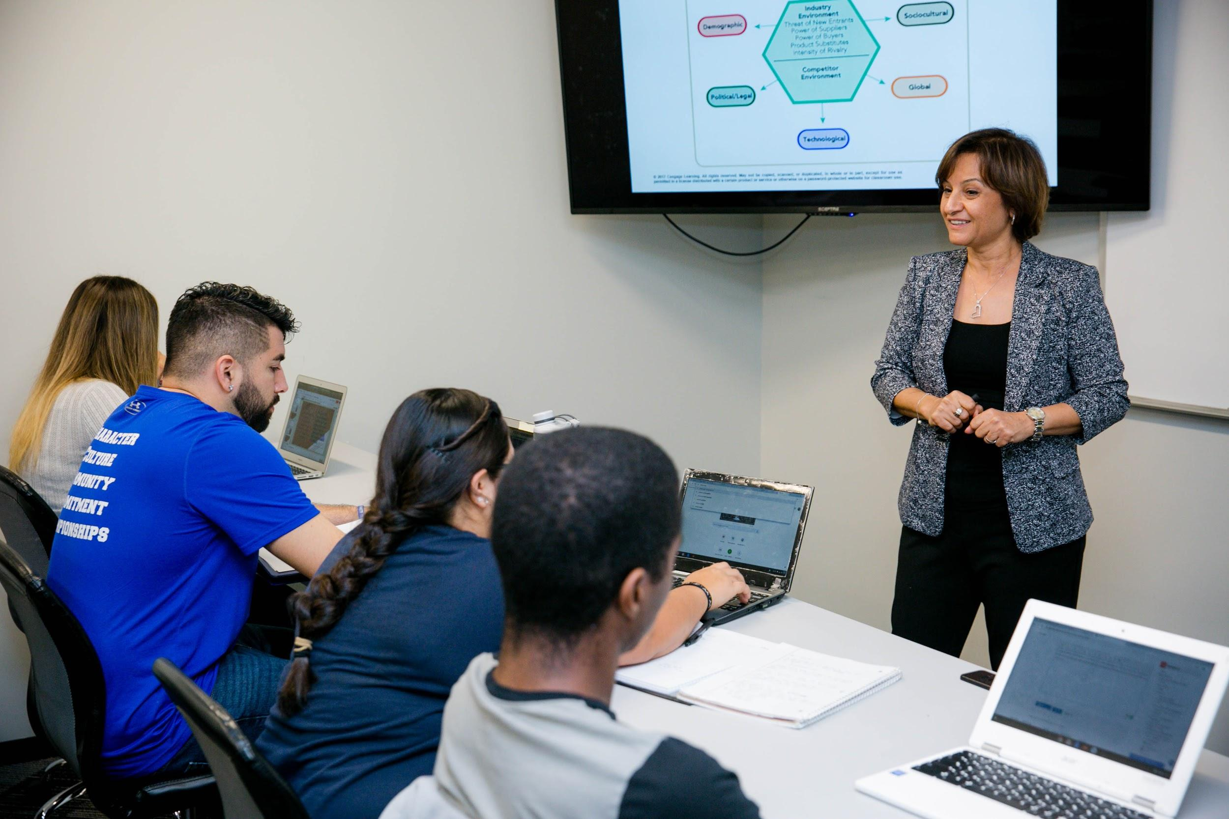
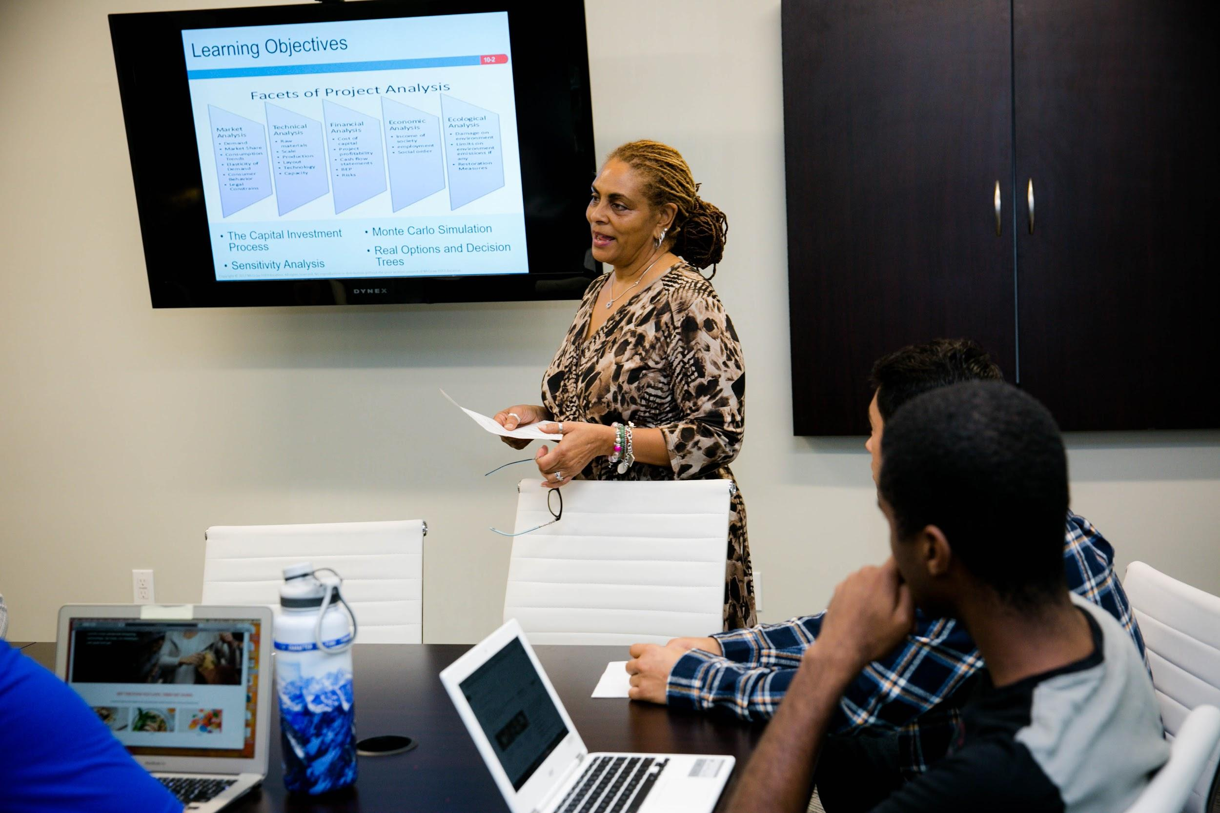
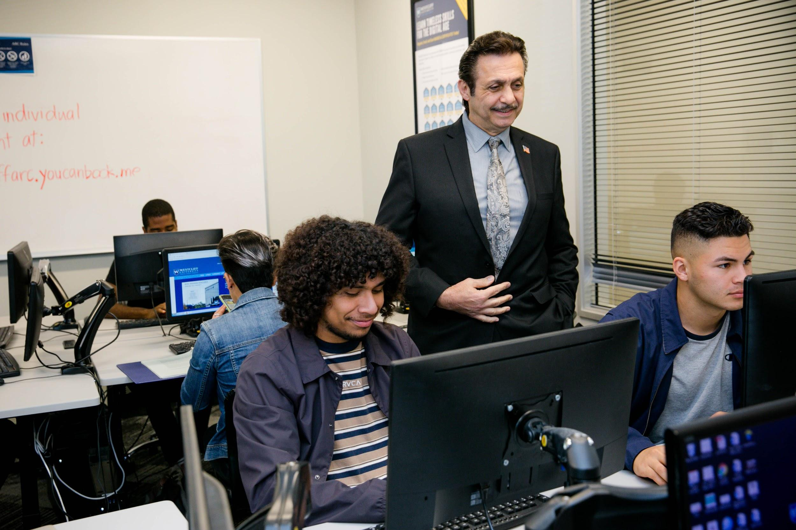
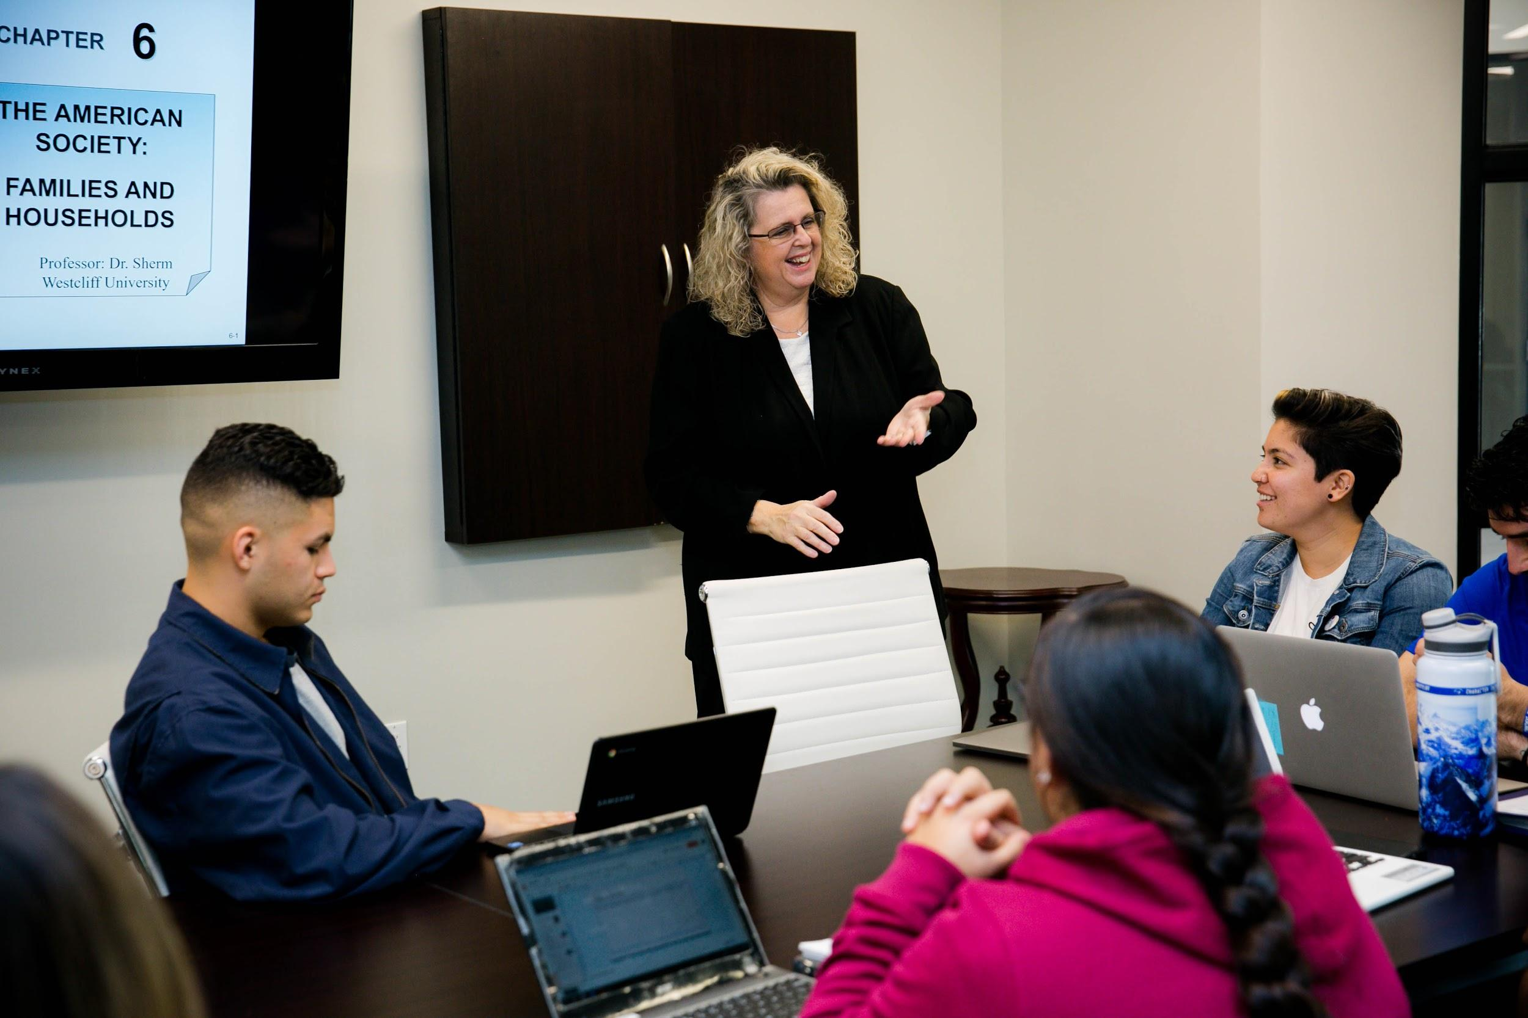
Faculty Photos
Template Resources

Slide 7
Stock Photos
Template Resources

