Slide 1
Instructions
Copy and Edit Away!
Consistency
Print and Help
To edit, go to File -> and select ‘Make a Copy’. There are editable regions within the template where you can begin to plug-in your content. Please do not edit the slide master (font type, placement, logo, color or general layout). We recommend printing these full-bleed (so the color meets the edge of the paper) at the University Print Shop or at Kinko’s on #100 velvet cover stock.
Please use Arial type font only. Follow general guidelines provided in sample for sizing and coloring of text.
To print, go to File>select Print>PDF> pick the slide number to print
Need help? Reach out to marketing. We are also happy to help if you need assistance editing in Google Slides or support during the printing process.

Slide 2
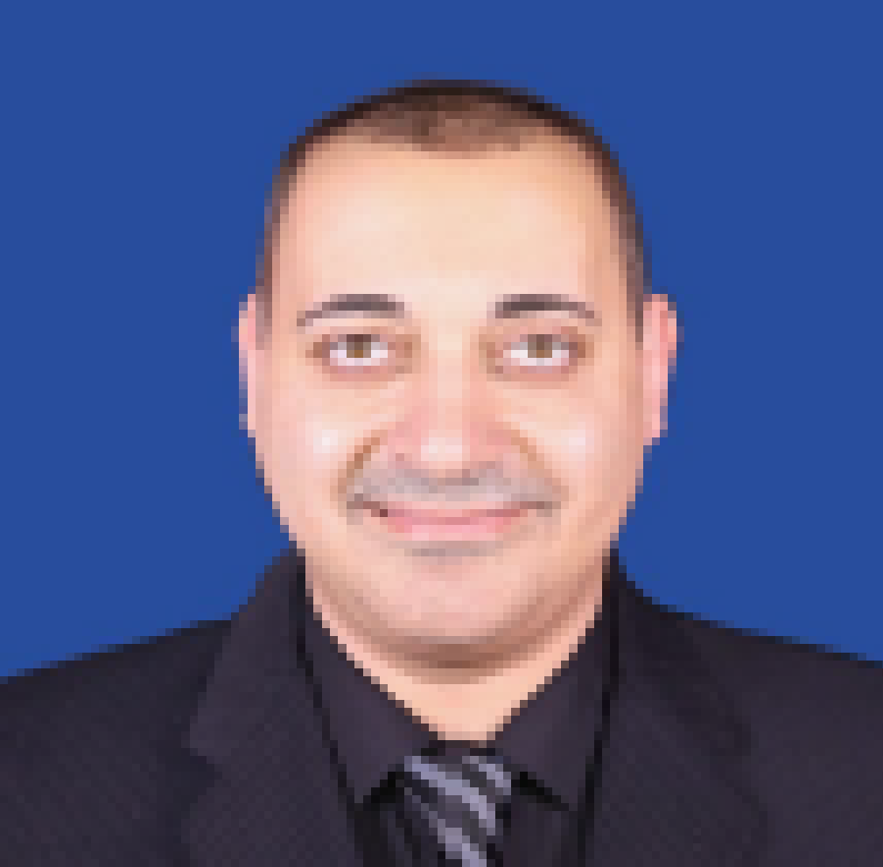
Thursday, October 8, 2020 | 6:00 PM - 7:00 PM | Online via Zoom
SAMPLE
Join us for a Q&A session with Dr. Sayegh & Dr. Haddad
Learn more about our program, share your career goals while receiving advice and answers to your questions
Dr. George J. Sayegh | Dean, College of Technology and Engineering
Dr. George J. Sayegh, Dean of the College of Technology and Engineering, has expertise and academic credentials in Computer Engineering, Business Administration, and Organizational Leadership. His career includes successful entrepreneurial ventures as well as working for NASA at JPL, Wangtek Drive Systems, and Ferranti Aerospace Missile Systems. His passion is to educate and infuse the minds of students with the knowledge that empowers them to succeed.
Dr. Omar Haddad | Faculty
Dr. Omar Haddad is an experienced software developer, data analyst, consultant, and project manager with companies such as Boeing and Accenture. Dr. Haddad’s enthusiasm for both STEM fields and business has made his recent focus promoting employability among college graduates by refining both technical and soft skills. Dr. Haddad holds a Doctorate of Business Administration with an emphasis on Information Systems as well as degrees and certificates from Carnegie Mellon University, the University of Michigan, and Wayne State University.
RSVP Here: bit.ly/WU_VMGSayeghHaddad

